Slide 1
Xamarin Forms: Visual Studio Tips and Tricks

Slide 2

Mitch Milam
Cloud Architect
mitch@xrmcoaches.com
blogs.Infinite–x.net
@mitchmilam

Slide 3
Teaching Tuesdays
Cast your vote now
http://tinyurl.com/TeachingTuesdays

Slide 4
Agenda
Creating your environment
Developing for
iOS
Android
Windows Phone
Building your solution
Discuss productivity tips

Slide 5
Creating Your Environment

Slide 6
Visual Studio (PC)
Platform | Notes
iOS | Requires Mac host
Android | Direct to Phone, Xamarin Player, Genymotion
Windows Phone | Direct to Phone, Emulator

Slide 7
Visual Studio (Mac/VM)
Create a virtual machine using Parallels or VMWare Fusion
Install
Visual Studio
Xamarin Tools for Visual Studio
Connect to the Mac host

Slide 8
Visual Studio (Mac/VM) – Caveats
No Windows Emulator
Can’t run a Hyper–V VM inside of another VM
Build Options
Windows phone (direct connect)
iOS (on the Mac host)
Android (Xamarin Android Player on Mac host)

Slide 9
iOS Development

Slide 10

iOS Development
iOS Toolbar
Connection Status
Disconnect from Build Server
Refresh Build Server Information
Clean Remote Server Log
Show iOS Simulator

Slide 11
iOS Development (cont.)
Only one Visual Studio instance on a machine can connect to the same iOS Build Host
Use the Disconnect button to disconnect one instance, then Refresh to connect another

Slide 12
Software Updates
Xamarin on the PC and Xamarin Mac must but in sync
Reboot is not generally required
Always stop and restart Xamarin Build Host after an update
Xcode
Reboot after any Xcode update

Slide 13
Android Development

Slide 14
Android Development
Android emulators (VirtualBox) do not coexist with Windows Hyper–V
Hyper–V must be disabled (reboot required)
dism.exe /Online /Disable-Feature:Microsoft-Hyper-V
Ignore “Hyper–V must be disabled” message

Slide 15
Android Development (cont.)
Xamarin Android Player is very fast
Some emulators are very unstable
Player is in beta and periodically expires

Slide 16
Windows Development

Slide 17
Windows Development
Windows Phone emulator uses Windows Hyper–V
Hyper–V must be enabled (reboot required)
dism.exe /Online /Enable-Feature:Microsoft-Hyper-V /All

Slide 18
Building Your Solution

Slide 19
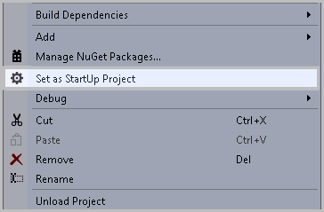
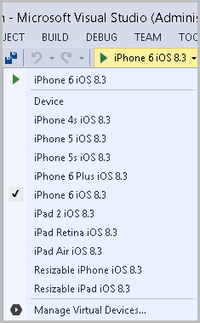
Build Considerations
The Startup Project determines device availability

Slide 20
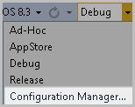
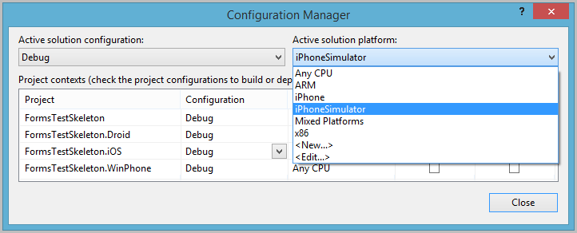
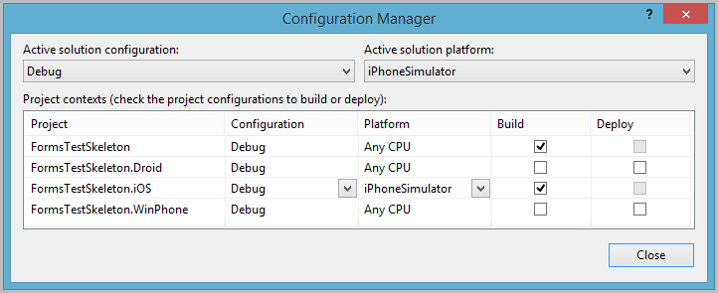
Build Considerations (cont.)
Configuration Manager Settings

Slide 21
General Build Principles
Only build projects you need
Perform a Build, Clean operation after any Xamarin update

Slide 22
Nuget
Nuget is sometimes the new “DLL Hell”
It may require you to manually clean your packages folder of older packages
Be cautious of version–specific Nuget package build requirements

Slide 23
Nuget
Still occasionally has issues with Resharper
Resharper can be enabled/disabled from the Command Window
ReSharper_ToggleSuspended

Slide 24
Productivity Tools and Tips
Remote Desktop software (GoToMyPC, etc.)
Temporarily disable your Anti–Virus real–time scanning
Watch your memory usage.
Visual Studio
Other applications

Slide 25
Productivity Tools and Tips (cont.)
Create a “Skeleton” project to try out new things
Create your own Visual Studio Templates
For projects
For items (classes)

Slide 26
What did I miss?

Slide 29
Visual Studio 2015?
Does anyone have any feedback or experiences to share?

Slide 30
Questions?

Slide 31
Thank You

